Slide 1
10-minute ABC challenge!
Gymnasium Celeanum

Slide 2
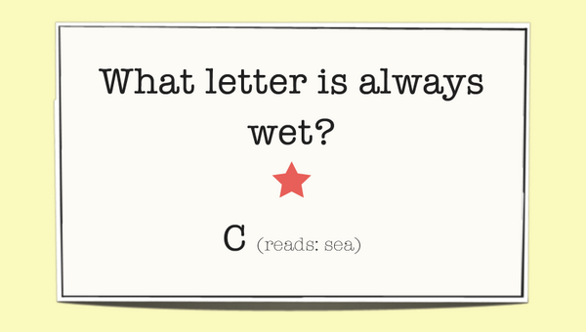
GOals
In this lesson you will learn:
the English alphabet
how to use a rhyme dictionary
Some interesting facts about our school

Slide 3
Assignment
Write an ABC poem!
The A is for apples, my favourite fruit.
The B is for bananas, they are also food.
Etc.
I have already written half a poem, but you guys have to finish it.
Make sure that each line rhymes with the previous line!

Slide 4
RHYME
It can be difficult to rhyme in English…
I will teach you in my verse,
Words like corpse, corps, horse and worse,
I will keep you, Suzy, busy,
Make your head with heat grow dizzy,
Tear in eye, your dress will tear,
So shall I! Oh hear my prayer!
(The chaos – Gerard Nolst Trenité)

Slide 5
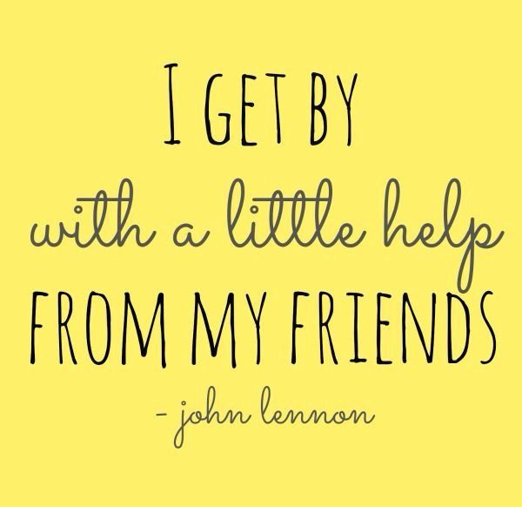
Rhymer.com
Use Rhymer.com on your phone to find words that rhyme with the provided lines.
How? Type in the final word of the previous line: fruit
Rhymer will provide suggestions!
=> food

Slide 6
Ready, set, go!
You now have 3 minutes to
come up with an interesting line
for your letter!
Write it down and be prepared to read it out loud.

Slide 7
Sharing is caring
Let’s hear what you’ve come up with!
Everyone will read their own line out loud.

Slide 8
The End
Thanks for joining us And we hope to see you soon!

